Slide 1
PhD Updates
Syed Salman Ahmed
Prof. Dr.-Ing. André Borrmann. Dr. Yelda Turkan, Florian Noichl
TUM Georg Nemetschek Institute / Chair of Computing in Civil and Building Engineering
Technical University of Munich.

Slide 2
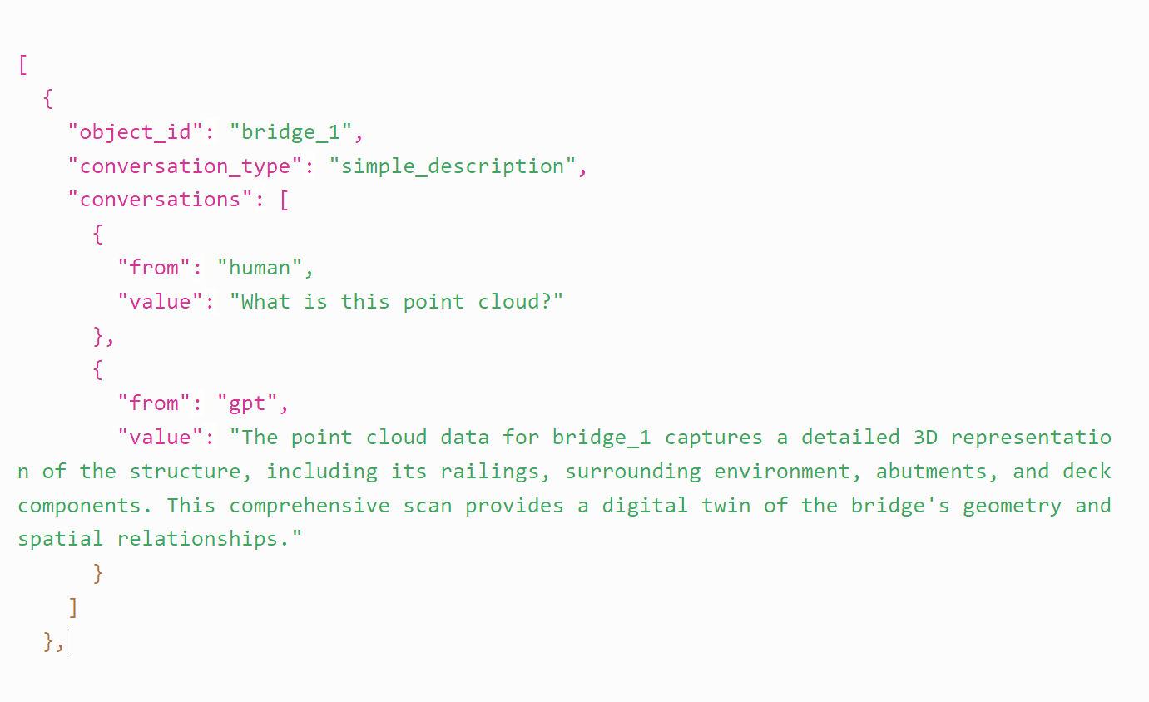

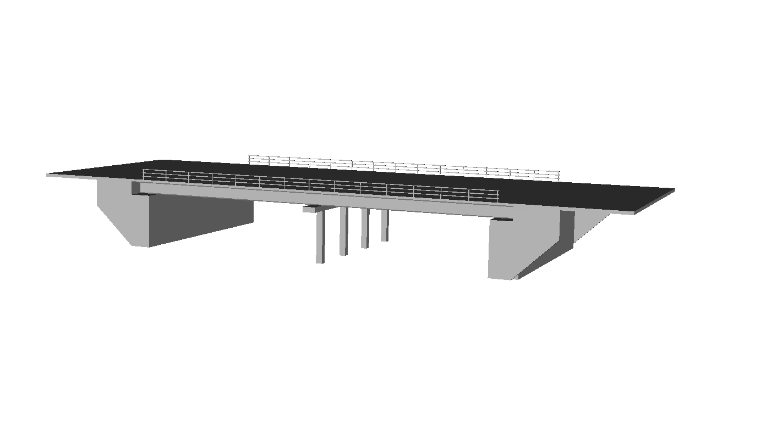
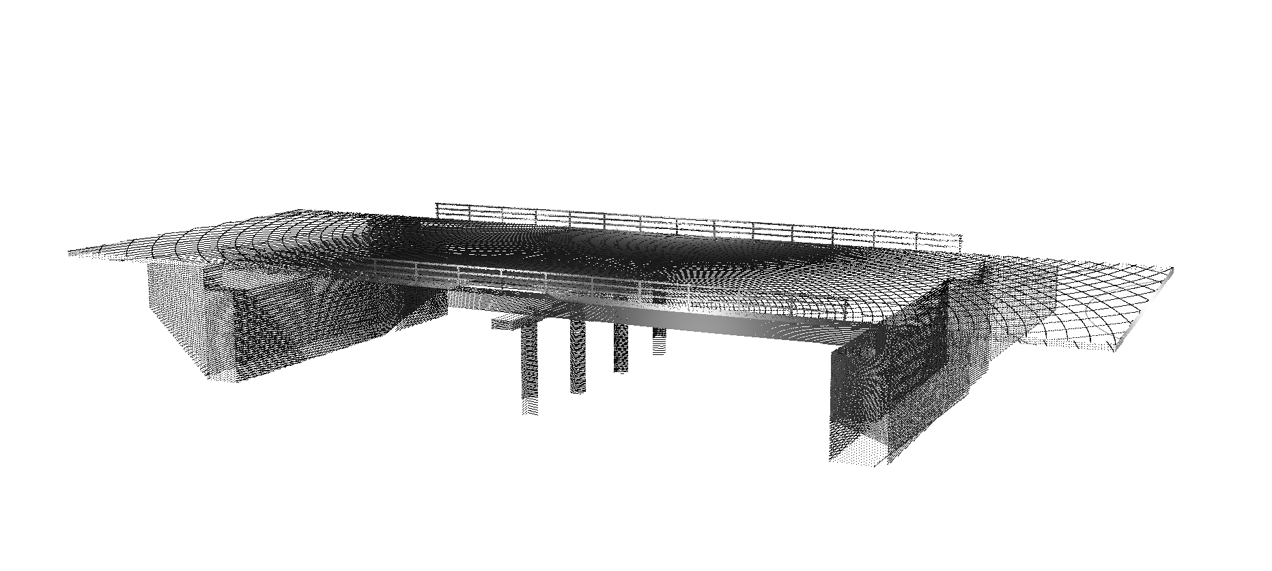

Conference Abstract
“An Open-Source Multimodal Dataset Generation Framework for RC Slab Bridge”
Accepted
3D Geometric models
Simulated Point Clouds
Natural language description
Code + Parametric information

Slide 3


Conference Abstract
For generating 3D geometric models
A Python-based repository with parametric information.
Use Helios + for simulation real point clouds
Use LLM APIs for chat-auto completion using parametric information
Future Step: BridgePointLLM

Slide 4
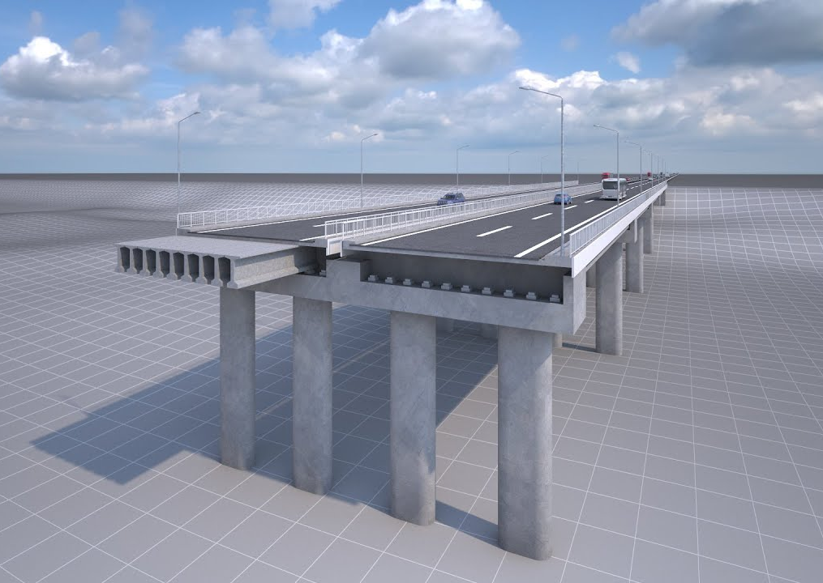
Refining Model: Assumptions
There are many ways to categorize bridges based on geometry, utility, structure, and construction type.
We are mostly concerned with Reinforced Concrete Highway/Motorway bridges.

Slide 5
Variations in bridge models
A modular code is written to produce variations.
This includes having some independent variables that are given to the code and some dependent variables that are computed.

Slide 6
Deck
Deck Sizes
Girder Type
Shoulder/sidewalks etc.
+
Width of lane
*
Number of lanes
Number of Spans
*
Span Length
Box Girder
T-Girder
Bridge Width
Bridge length
Span to Depth ratio
Piers
Number of beams/cells
Girder Geometry
Girder Depth
Column-shape
Pier Type
Number of Piers
Rectangular
Circular
MultiColumn
HammerHead
Girders
Girder
Pier Cap Type
Railing
Abutment
Prismatic
Railing geometry
Railing Length
Abutment Type
WingWall
Wingwall Geometry
Bridge Clearance height

Slide 7
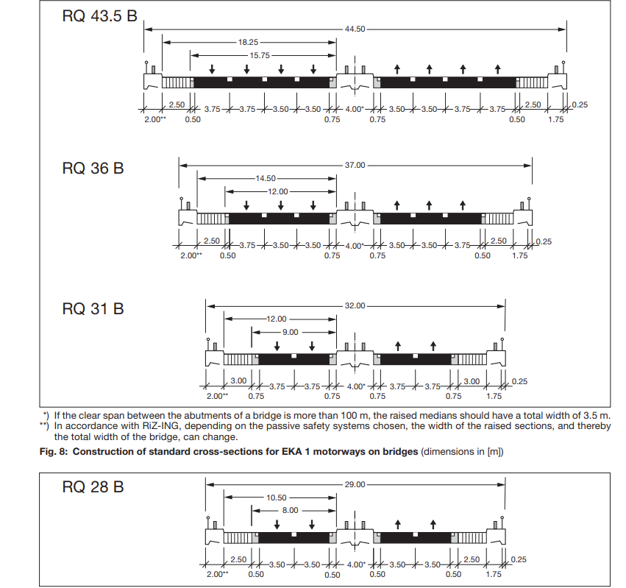
Deck | Width
Richtlinien für die Anlage von Autobahnen FGSV
Road and Transportation Research Association
Notes:
Deck Width ( number of lanes ).
Number of lanes: Random between 2 and 4
lane_width = 3.5
hard_shoulder = 3.0
hard_strip = 0.5
sidewalk = 1.5 if include_sidewalks else 0.0
Total_width = lanes * lane_width + 2 * (hard_shoulder + hard_strip)

Slide 8
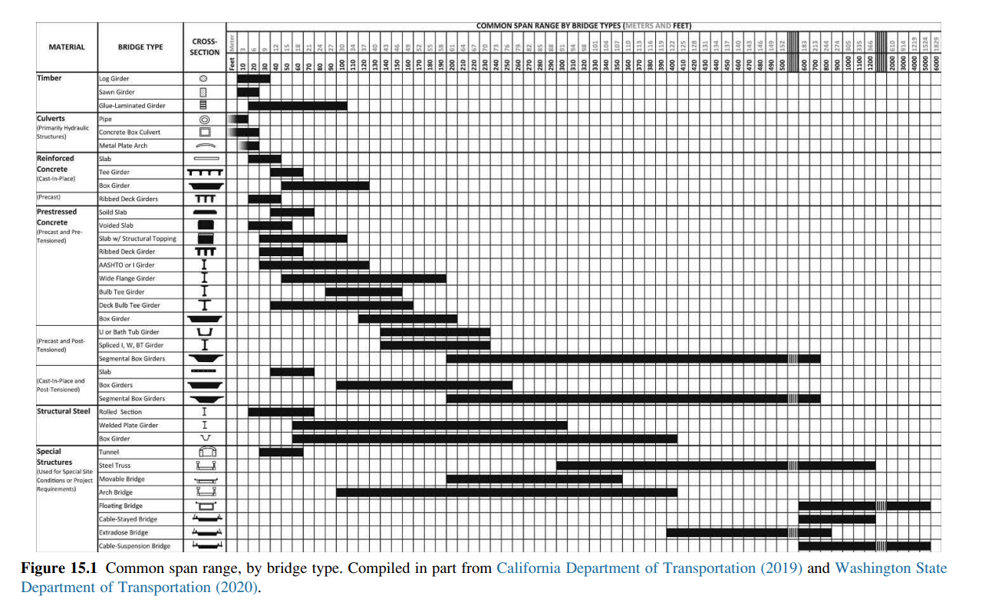
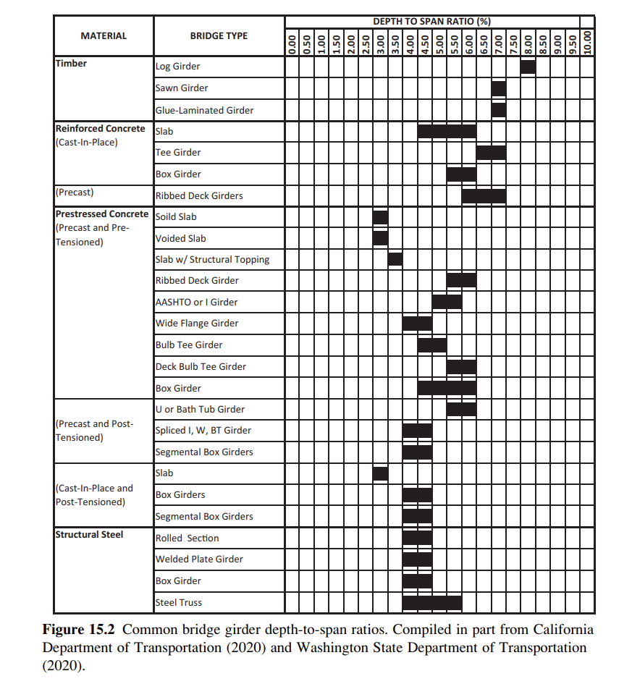
Deck | Span length and Span-to-depth ratio
Innovative-Bridge-Design-Handbook-Construction-Rehabilitation-and-Maintenance-1.pdf
Notes:
Deck Width ( number of lanes ).
Number of lanes: Random between 2 and 4
lane_width = 3.5
hard_shoulder = 3.0
hard_strip = 0.5
sidewalk = 1.5 if include_sidewalks else 0.0
Total_width = lanes * lane_width + 2 * (hard_shoulder + hard_strip)

Slide 9
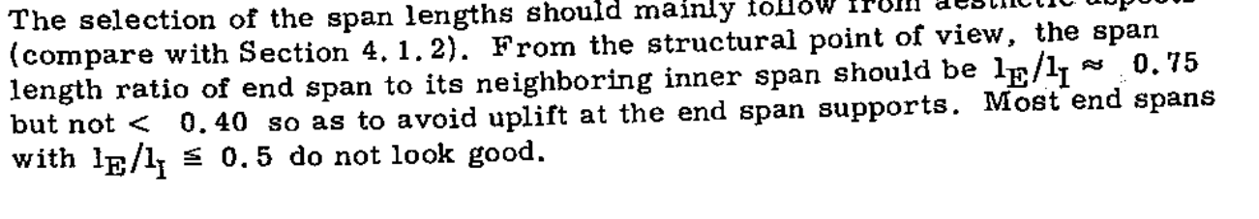
Deck | Inner span-to-End Span Ratio )
Concrete Box Girder Bridges Guide - J Schlaich, H. Scheffer

Slide 10
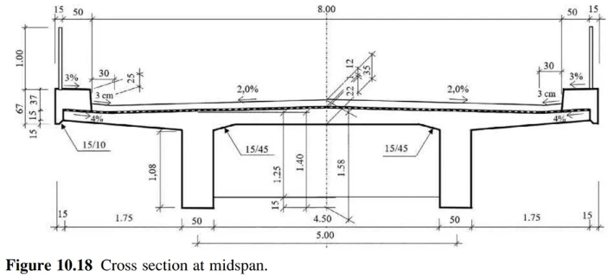
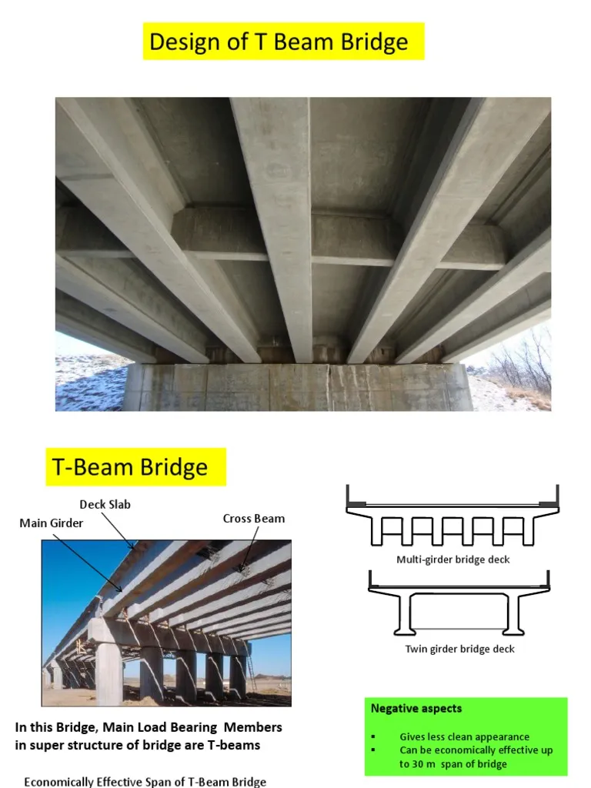
T Girder / Beam and Slab Girder
z
y
Innovative-Bridge-Design-Handbook-Construction-Rehabilitation-and-Maintenance-1.pdf

Slide 11
T Girder | Beam and Slab Girder
z
Deck width = = lanes * lane_width + 2 * (hard_shoulder + hard_strip))
Deck Thickness = 300 mm
y
Girder depth = Effective span length / 18.0
Girder thickness = 500 mm
Girder Spacing = (3.5, 4.5)
Innovative-Bridge-Design-Handbook-Construction-Rehabilitation-and-Maintenance-1.pdf

Slide 12
T Girder / Beam and Slab Girder
z
Deck width = = lanes * lane_width + 2 * (hard_shoulder + hard_strip))
Deck Thickness = 300 mm
y
Girder depth = Effective span length / 18.0
Girder thickness = 500 mm
Girder Spacing = (3.5, 4.5)
Number of girder = width / 3.5
Innovative-Bridge-Design-Handbook-Construction-Rehabilitation-and-Maintenance-1.pdf

Slide 13
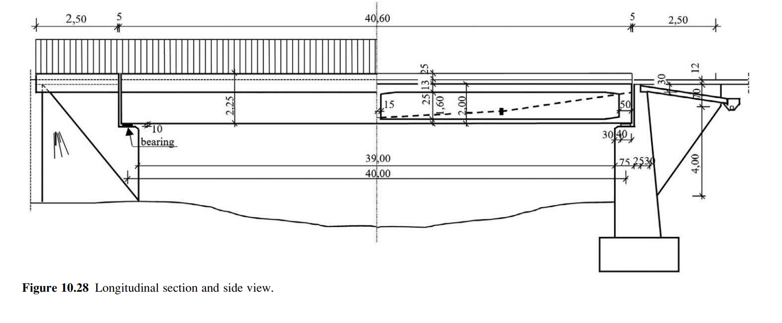
Box Girder
z
y
Innovative-Bridge-Design-Handbook-Construction-Rehabilitation-and-Maintenance-1.pdf

Slide 14
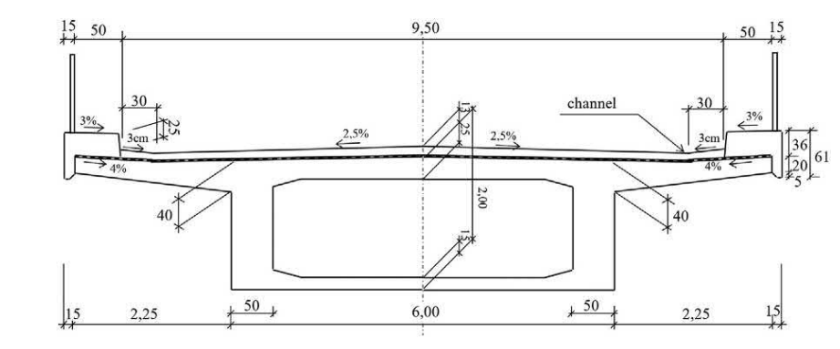
Box Girder
z
y
Number of cells, Girder Depth, Cell web thickness

Slide 15
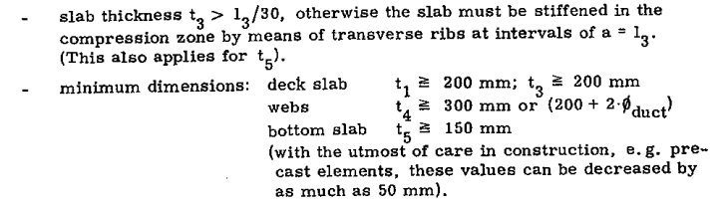
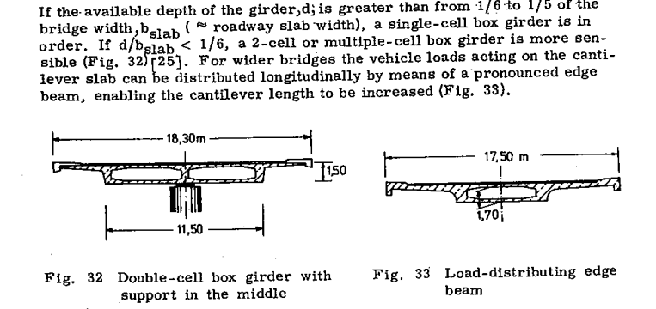
Box Girder
z
y
Top slab thickness = 250 mm
Box_height = 2 m
Bottom slab thickness = 150 mm
Web thickness = 0.5
Cell_ratio = depth_of_girder / total_width_m
Number of cells depends on cell ratio
Number of cells, Girder Depth, Cell web thickness
Concrete Box Girder Bridges Guide - J Schlaich, H. Scheffer
Innovative-Bridge-Design-Handbook-Construction-Rehabilitation-and-Maintenance-1.pdf

Slide 16
Box Girder
z
y
Cell ratio between 1/6 to 1/5 -> 1 cells
Cell ratio less than 1/6 -> 2 cells.
Concrete Box Girder Bridges Guide - J Schlaich, H. Scheffer
Innovative-Bridge-Design-Handbook-Construction-Rehabilitation-and-Maintenance-1.pdf

Slide 17
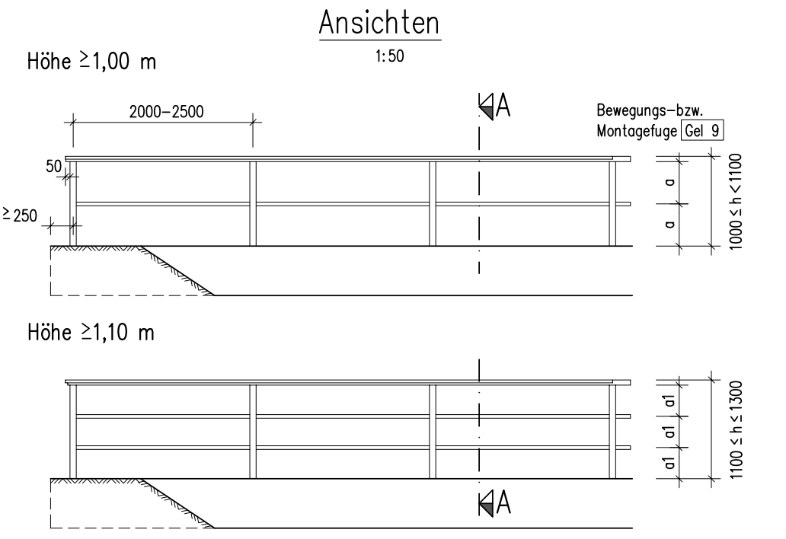
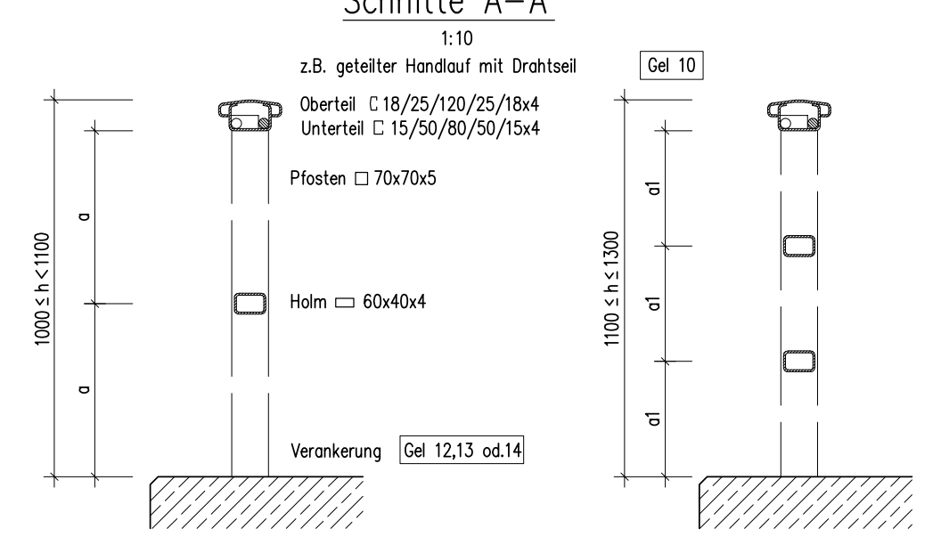
Railings
z
x
Richtzeichnungen für Ingenieurbauten 2023

Slide 18
z
Railing height = 1.0 m
We will assume that the railing post is 7cm square in xy plane
x
Center-center distance = 2.5 m
0.07 thickness

Slide 19
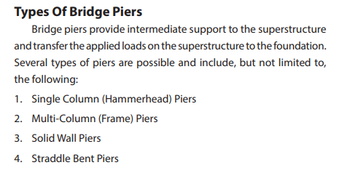
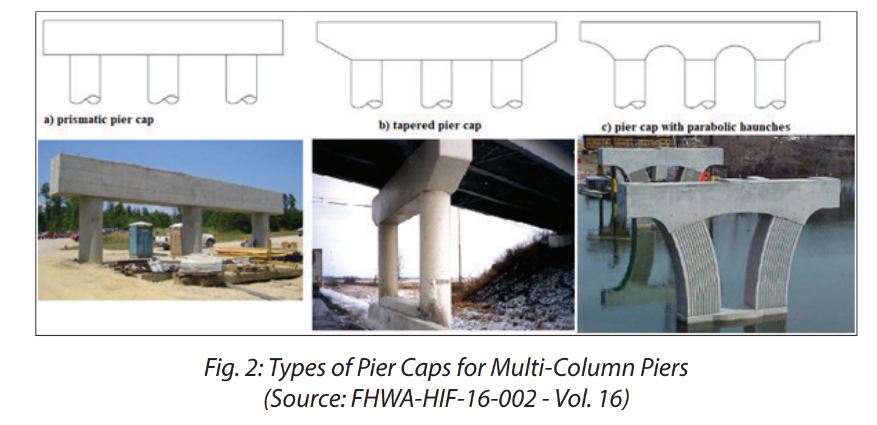
Piers | Types
Column-shape
Pier Type
Number of Piers
Rectangular
Circular
MultiColumn
HammerHead
Pier Cap Type
Prismatic
NS_2020_Design_Of_Bridge_Piers_And_Pier.pdf

Slide 20
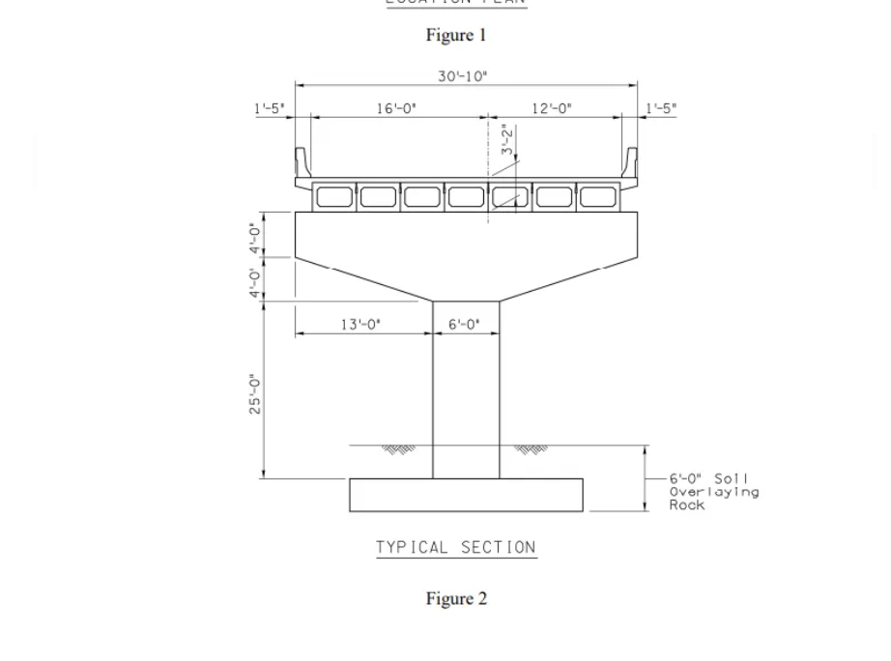
Piers | Hammerhead
z
y
p5
p4
p3

Slide 21
Abutment | Wing wall
Wing wall
y
x

Slide 22
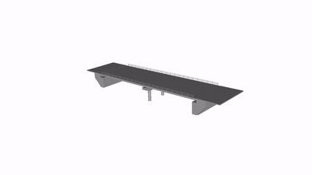
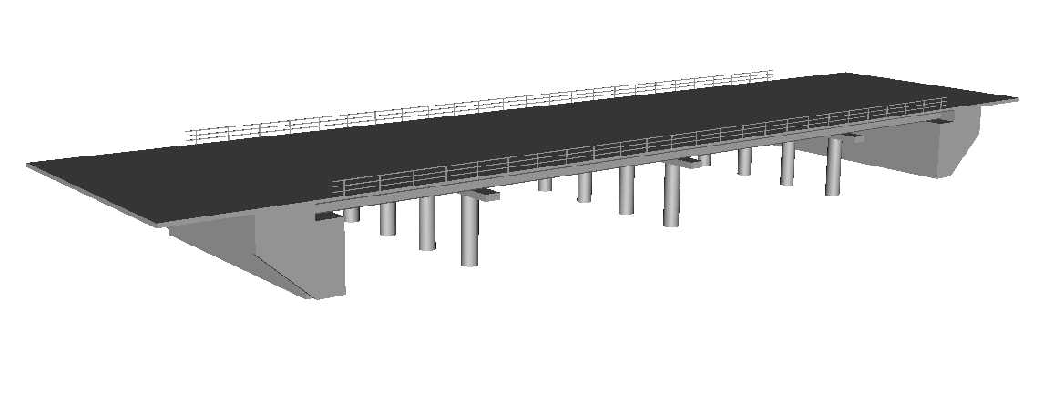
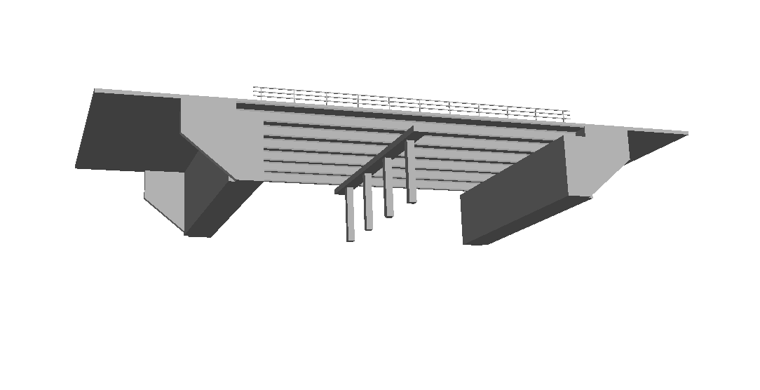
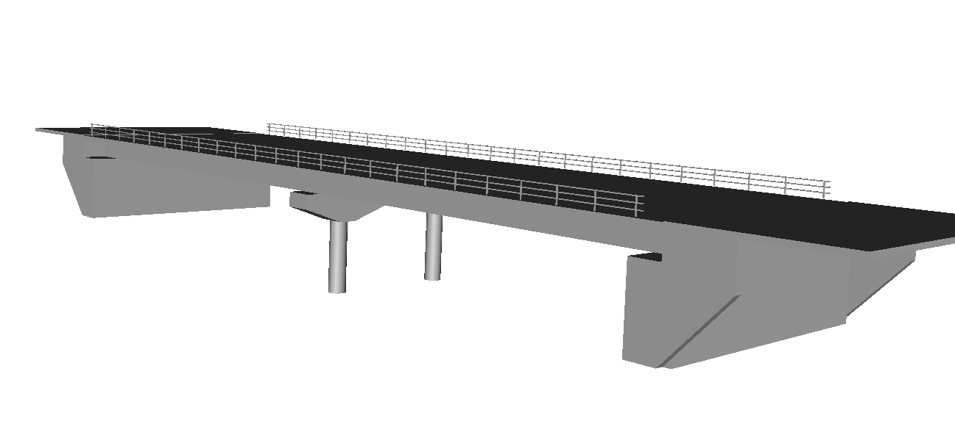
Final Models

Slide 23
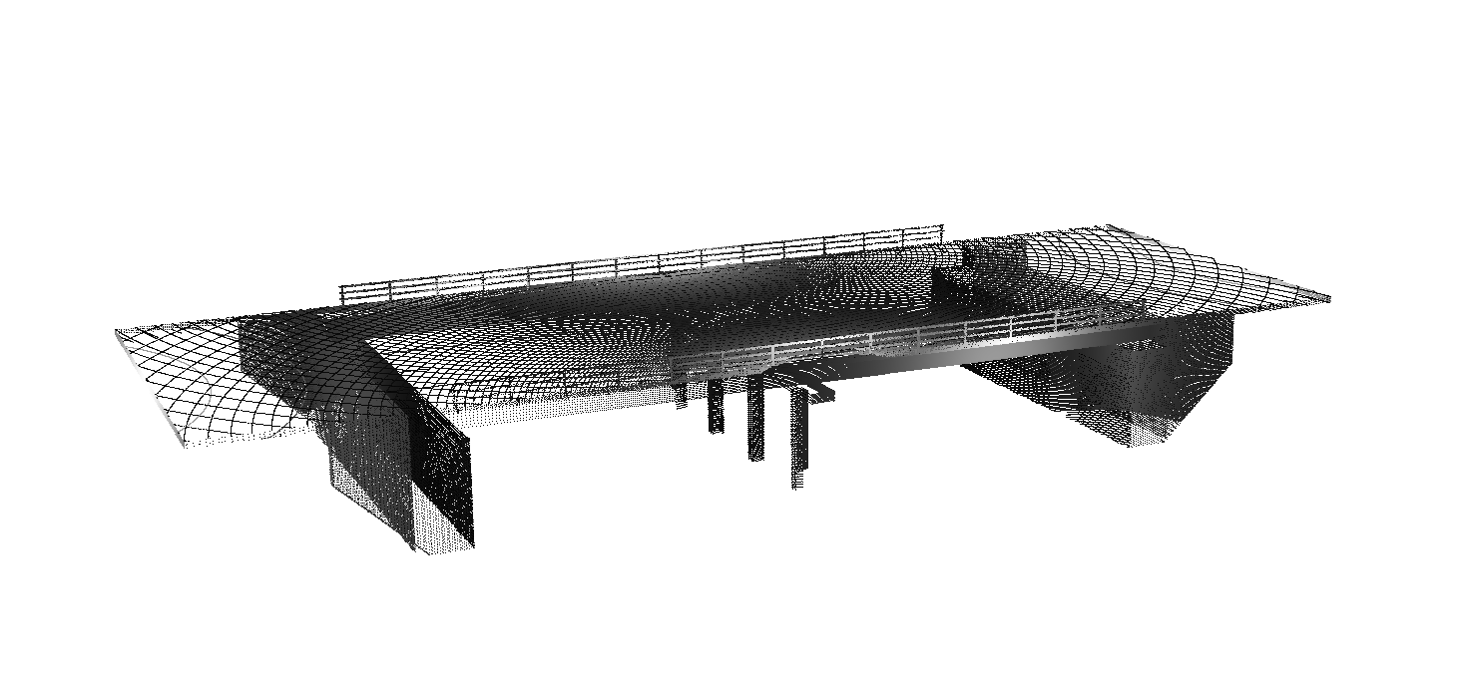
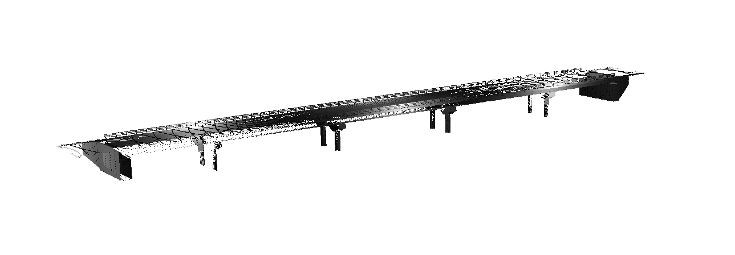
Final Models

